Slide 1
Rest Web Services
Frictionless Flow of Information

Slide 2
REST Web Services
REST = REpresentational State Transfer
REST is an architectural style consisting of a coordinated set of architectural constraints
First described in 2000 by Roy Fielding in his doctoral dissertation at UC Irvine.
RESTful is typically used to refer to web services implementing a REST architecture.
Alternative to other distributed-computing specifications such as SOAP.
Simple HTTP client/server mechanism to exchange data
Everything – the UNIVERSE is available through a URI
Utilizes HTTP: GET/POST/PUT/DELETE operations

Slide 3
Architectural Constraints
Client–server
  Separation of concerns. A uniform interface separates clients from servers.
Stateless
  The client–server communication is further constrained by no client context being stored on the server between requests.
Cacheable
  Basic WWW principle: clients can cache responses as well as servers across the network
Layered system
  A client cannot necessarily tell whether it is connected directly to the end server, or to an intermediary along the way.
Uniform interface
  Individual resources are identified in requests, i.e.,using URIs in web-based REST systems.

Slide 4
RESTful Web Services
No significant tools required to interact with the Web service
Short learning curve
Efficient REST can use concise message formats
Fast (no extensive processing required)
Close to other Web technologies in design philosophy
Explosive growth in commercial end user applications
Does NOT follow a prescribed standard beyond HTTP spec

Slide 5
RESTful API HTTP methods
Resource | GET | PUT | POST | DELETE
Collection URI, such as http://example.com/resources | List the URIs and perhaps other details of the collection's members. | Replace the entire collection with another collection. | Create a new entry in the collection. The new entry's URI is assigned automatically and is usually returned by the operation. | Delete the entire collection.
Element URI, such as http://examples .com /resources/item17 | Retrieve a representation of the addressed member of the collection, expressed in an appropriate Internet media type. | Replace the addressed member of the collection, or if it doesn't exist, create it. | Not generally used. Treat the addressed member as a collection in its own right and create a new entry in it. | Delete the addressed member of the collection
A resource can be a singleton or a collection. For example, “customers” is a collection resource and “customer” is a singleton. We can identify “customers” collection resource using the URN “/customers”. We can identify a single “customer” resource using the URN “/customers/{customerId}”.
POST means "create new" as in "Here is the input for creating a customer".
PUT means “create OR replace if already exists" as in "Here is the data for user 5".
PUT is Idempotent
Create support via PUT depends on whether the client can meaningfully assign a URI to a resource before it exists.
[Not possible with DB generated PK]
Idempotent means that multiple calls with the same operation doesn’t change the representation
@RequestMapping("/{id}")
public Member getMemberById(@PathVariable("id") Long id) {
Notes:
It is still possible, that safe methods do change things on a server or resource, but this should not reflect in a different representation.
PUT being Idempotent does NOT mean SAFE as the first call can change the representation…as well as subsequent can change timestamp etc..
Use PUT to UPDATE data ………….idenmpotent
- Use POST to ADD data
- Use DELETE to REMOVE data
Use GET to RETREIVE data
https://en.wikipedia.org/wiki/Representational_state_transfer
https://knpuniversity.com/screencast/rest/put-versus-post
http://zacharyvoase.com/2009/07/03/http-post-put-diff/
https://stormpath.com/blog/put-or-post
POST means "create new" as in "Here is the input for creating a customer, create it for me".
PUT means "insert, replace if already exists" as in "Here is the data for user 5".
You POST to example.com/users since you don't know the URL of the user yet, you want the server to create it.
You PUT to example.com/users/id since you want to replace/create a specific user.

Slide 6
JSON (JavaScript Object Notation)
{
"productId":"P1235",
"name":"Dell Inspiron",
"unitPrice":700,
"description":"Dell Inspiron 14-inch Laptop (Black) with 3rd Generation Intel Core processors",
"manufacturer":"Dell",
"category":"Laptop",
"unitsInStock":1000,
"unitsInOrder":0,
"discontinued":false,
"condition":null
}

Slide 7
Main Point
REST is defined by architectural constraints. It is able to access information through the ubiquitous URI. Everything on the web is available through a URI.
Likewise, everything in creation is known through understanding and experience of the Unified Field of Consciousness

Slide 8
Spring Rest Web Service Technologies Using MVC REST-style Controller
“Re-uses” @Controller
Essentially means receive & send the content directly as the message body instead of structuring HTML pages.
We are NOT using HTML
We are using well-formed XML OR JSON
Spring support is based on the
@REQUESTBODY & @RESPONSEBODY annotations
@ResponseStatus(value = HttpStatus.NO_CONTENT)
For deletes, creates, updates…

Slide 9
RequestBody & ResponseBody
@ResponseBody
  Spring framework uses the "Accept" header of the request to decide the media type to send to the client
@RequestBody
  Spring framework will use the “Content-Type” header to determine the media type of the Request body received.
  To get XML, MIME media type = "application/xml"
  To get JSON, MIME media type = "application/json “

Slide 10
RESTful Web Service Controller
@RequestMapping(“/products”)
Class Product
No Request OR Response Data
@RequestMapping(value = "/{productId}", method = RequestMethod.DELETE)
@ResponseStatus(value = HttpStatus.NO_CONTENT)
public void deleteItem(@PathVariable("productId") String productId,
HttpServletRequest request) {
Response Data
@RequestMapping("", method = RequestMethod.GET)
public @ResponseBody List<Product> getRestProduct(){
Request & Response Data
@RequestMapping("", method = RequestMethod.POST)
public @ResponseBody Product saveRestProduct(@RequestBody Product product){

Slide 11
Spring MVC Rest Controller Annotation Alternatives
@RestController
@RequestMapping({"/books"})
public class BookController {
@Autowired
BookService bookService;
@GetMapping("")
public List<Book> findAll() {
return bookService.findAll();
}
@PostMapping("")
public void add( @RequestBody Book book) {
bookService.save(book);
return ;
}
@RestController
“automatically” assumes return object is REST related
[implicit @ResponseBody]
Uses composed annotations for REST -
For example @GetMapping("") ==
@RequestMapping(value="", method = RequestMethod.GET).

Slide 12
Spring MVC [Continued]
@GetMapping(value= "/{title}")
public Book findOne(@PathVariable("title") String title) {
return bookService.findOne(title);
}
@DeleteMapping("/{title}")
public void delete(@PathVariable("title") String title) {
bookService.delete(title);
return;
}
@PutMapping(value= "/{title}")
public void update(@PathVariable("title") String title, @RequestBody Book updateBook) {
bookService.delete(title);
bookService.update(updateBook);
return;
}

Slide 13
Basic and Digest Authentication
Basic authentication
Handshake based on HTTP headers**
Transmits username/password as “plain text”
Base64 encoding
Used in conjunction with SSL-HTTPS**
Used with form-based authentication**
Secure data at rest
Digest Authentication
Transmits encrypted username/password
“Double” handshake to get hash “seed”
More complex – more vulnerable
** Web based
Notes:
special code (called a nonce)

Slide 14
Restful Web Service with Spring Security
Restful web service is stateless
No HTTP sessions
Re-authenticate on every request
Server Configuration:
<!-- Stateless RESTful services use BASIC authentication -->
<security:http create-session="stateless"
pattern="/**" use-expressions="true">
<security:intercept-url pattern="/**" access="hasRole('ROLE_ADMIN')"/>
<security:http-basic/>
<security:csrf disabled="true"/>
</security:http>
Better Solution: OAuth2
Basic authentication transmits as plain text need HTTPS
Cross Site Request Forgery
service - for non-browser clients
disable CSRF protection

Slide 15
Client Side Authentication
CREATE HTTP Authorization header
String auth = username + ":" + password;
byte[] encodedAuth = Base64.encodeBase64(
auth.getBytes(Charset.forName("US-ASCII")) );
String authHeader = "Basic " + new String(encodedAuth)
HEADER:
Authorization: Basic aHR0cHdhdGNoOmY=
Declares Basic & includes encoded credentials
Notes:
http://www.baeldung.com/how-to-use-resttemplate-with-basic-authentication-in-spring#manual_auth
Manual .vs. automatic Authentication
http://www.baeldung.com/securing-a-restful-web-service-with-spring-security
http://www.webperformance.com/load-testing/blog/2011/06/how-http-authentication-works-and-why-load-testers-should-care/
Server sends WWW-Authenticate Header with value == BASIC
Client responds with Authentication Header == BASIC + Base64

Slide 16
Spring Rest Template
Client side access
“Conventional” use of a REST web service is programmatic:
NOT Browser based…
Spring provides a convenient template class:
RestTemplate
Simplified Interaction with RESTful services
Often a one-line incantation.
Can bind data to custom domain types
Spring RestTemplate
Also Convenience Class often used with RestTemplate :
HttpEntity
Represents HTTP Payload [Request & Response]
Contains Http headers & Body
Spring HttpEntity
Another Convenience Class:
HttpHeaders
Contains Map of HTTP headers Spring HttpHeaders

Slide 17
RestTemplate Example
Setup HttpHeaders Example [RestHttpHeader.java]:
HttpHeaders requestHeader = new HttpHeaders();
requestHeader.setAccept(Collections.singletonList(MediaType.APPLICATION_JSON))
requestHeader.setContentType(MediaType.APPLICATION_JSON);
requestHeader.set("Authorization", authHeader);
Setup HttpEntity Example:
HttpEntity headerOnly = new HttpEntity(requestHeader);
HttpEntity headerWithBody =
new HttpEntity<Member>(member,requestHeader);
RestTemplate Examples [e.g., ProductRestServiceImpl.java]:
String baseUrl = "http://localhost:8080/MemberRest/members";
String baseUrlExtended = baseUrl + "/";
restTemplate.exchange(baseUrlExtended + index, HttpMethod.GET, headerOnly ,
Member.class).getBody());
restTemplate.exchange(baseUrl, HttpMethod.GET, headerOnly , Member[].class );
restTemplate.postForObject(baseUrl, headerWithBody, Member.class);
Create HttpEntity with only headers
Create HttpEntity with headers and body.
Notes:
restTemplate.getForObject(url, User.class); -- THERE is no way to send HEADERS!!! – use exchange

Slide 18
Main Point
The Spring framework makes the transition to RESTful web services smooth though the flexible & adaptable design of Spring MVC controllers.
The Structure of Life is flexible & adaptable.

Slide 19
REST API Conventions
Google API
The resource name is organized hierarchically using collection IDs and resource IDs, separated by forward slashes. If a resource contains a sub-resource, the sub-resource's name is formed by specifying the parent resource name followed by the sub-resource's ID - again, separated by forward slashes.
Relationships
GET /orders/12/items - Retrieves list of addresses for member 12
GET /orders/12/items /5/products/1 - Retrieves product[s] for item 5 of order 12
POST /orders/12/items - Creates a new item associated with order 12
PUT /orders/12/items/5 - Updates item #5 for order #12
DELETE /orders/12/items/5 - Deletes address #5 for member #12
Resources are NOUNS not verbs
members .vs. getMembers
endpoints are plural
members .vs. member
Notes:
PATCH /tickets/12/messages/5 - Partially updates message #5 for ticket #12
If a relation can exist independently of the resource, it makes sense to just include an identifier for it within the output representation of the resource. The API consumer would then have to hit the relation's endpoint. However, if the relation is commonly requested alongside the resource, the API could offer functionality to automatically embed the relation's representation and avoid the second hit to the API.
Resources are NOUNS not verbs
products .vs. getProducts
endpoints are plural
/products vs. /product
String baseUrl = "http://localhost:8080/MemberRest/members";
there is some conceptual alignment between storage systems and REST APIs, a service with a resource-oriented API is not necessarily a database, and has enormous flexibility in how it interprets resources and methods.

Slide 20
Microsoft API guidelines
Microsoft API
In more complex systems, there can be URIs that enable a client to navigate through several levels of relationships:
/orders/12/items/5/products/1
The complexity level can be difficult to maintain and is inflexible
Keep URIs relatively simple.
The preceding query can be replaced with the URI
/orders/12 /items
to find the items associated with order 12, and then
/items/5/products
to get products associated with item 5.
/products/1
to get product
Microsoft Tip:
Avoid requiring resource URIs more complex than collection/resource/collection.
Notes:
https://phauer.com/2015/restful-api-design-best-practices/
Good example
Explains different ways to describe relationships: links, sideloading & embedded
https://blog.restcase.com/7-rules-for-rest-api-uri-design/
Sending an HTTP GET request to the collection URI retrieves a list of items in the collection. Each item in the collection also has its own unique URI. An HTTP GET request to the item's URI returns the details of that item.

Slide 21
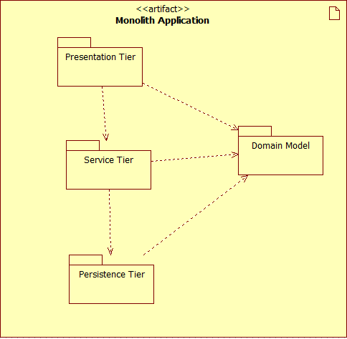
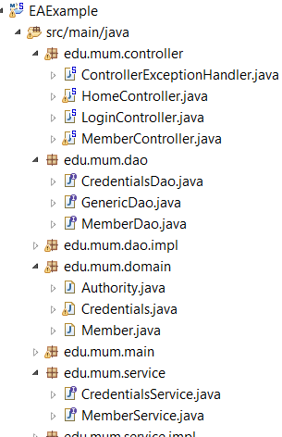
Monolith N-Tier
This is what we built with Spring MVC [last lesson]
See MemberSpringMVC Demo

Slide 22
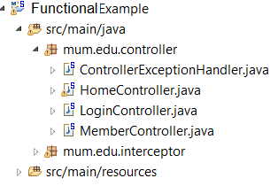
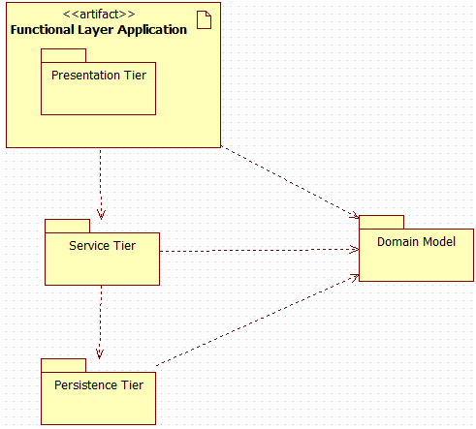
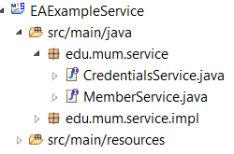
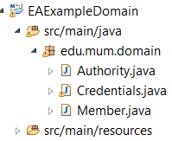
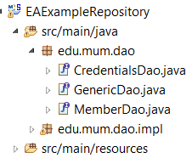
Functional N-Tier
More Flexible - Scalable
Restful API
X
X
What if – we “detached” the Service Tier & the Persistence Tier?
And create a Rest based business application…

Slide 23
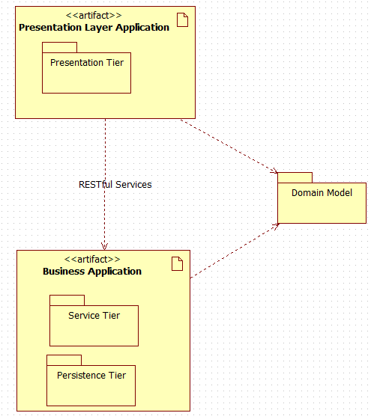
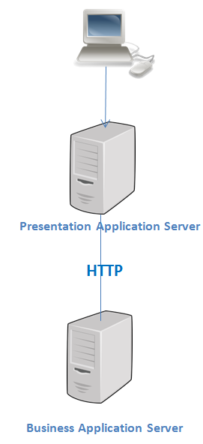
RESTful Business Layer
MemberMVC Demo
MemberRest Demo

Slide 24
JSON Lazy Loading
Hibernate lazy initialization exception results from attempting JSON serialization on
JsonMappingException: failed to lazily initialize
@OneToMany(fetch=FetchType.LAZY)
private List<Address> addresses = new ArrayList<Address>();
SOLUTION:
Configure HibernateAwareObjectMapper
[Registers Hibernate4Module ] **
Returns null if Lazy loading OR Collection if Collection hydrated
<mvc:message-converters>
<bean class=
"org.springframework.http.converter.json.MappingJackson2HttpMessageConverter">
<property name="objectMapper">
<bean class="edu.mum.rest.HibernateAwareObjectMapper" />
</property>
</bean>
</mvc:message-converters>
** Hibernate4Module : add-on module forJackson JSON processor which handles Hibernate Lazy Loading
Postman Demo:
http://localhost:8080/MemberRest/products/1
http://localhost:8080/MemberRest/products/1/categories
Notes:
http://stackoverflow.com/questions/28746584/how-to-avoid-lazy-fetch-in-json-serialization-using-spring-data-jpa-spring-web

Slide 25
[Some] JSON Annotations
@JsonIgnoreProperties
Class level annotation - list of properties properties to be excluded.
EXAMPLES:
In Address class:
@JsonIgnoreProperties(value="member") Always ignore in Address
public class Address {
OR
In Member class:
@JsonIgnoreProperties(value="member") Ignore when accessing Member Address List
private List<Address> addresses = new ArrayList<Address>();
@JsonIgnore
Field level annotation - properties to be excluded are marked one by one.
EXAMPLE:
In Address class:
@JsonIgnore
private Member member;
use @JsonView if you want to dynamically determine which field(s) to skip
JSON Annotations

Slide 26
JSON Annotations [Cont.]
@JsonManagedReference && @JsonBackReference [ Bidirectional]
@JsonManagedReference is the “front” part of reference – the one that gets serialized normally.
@JsonBackReference is the back part of reference – it will be omitted from serialization.
Example:
In Member class:
@JsonManagedReference()
private List<Address> addresses = new ArrayList<Address>();
In Address class:
@JsonBackReference()
private Member member; Always ignore
_________________________________________________________________
@JsonIdentityinfo [Bidirectional]
Serialize the first instance as full object [JSON object identity], subsequent references use reference values.
Examples:
@JsonIdentityInfo(generator=ObjectIdGenerators.IntSequenceGenerator.class, property="@jid")
public class UserCredentials {
@JsonIdentityInfo(generator=ObjectIdGenerators.PropertyGenerator.class, property="id")
public class Member {
JSON generated ID
Use Class ID
Notes:
see http://wiki.fasterxml.com/JacksonFeatureBiDirReferences

Slide 27
JSON Bidirectional
Circular Dependency
For Jackson to work well, one of the two sides of a bidirectional relationship should NOT be serialized
In order to avoid an infinite recursive loop that causes a stackoverflow error.
Example Solutions….
NOTE: Postman gives access to the JSON content

Slide 28
JsonManagedReference /JsonBackReference
public class Member {
@JsonManagedReference
UserCredentials userCredentials;
GET for Member: [gets UserCredentials]
{
"id": 1,
"firstName": "Curious",
"lastName": "George",
"age": 12,
"title": "Boy Monkey",
"memberNumber": 8754,
"userCredentials": {
"username": "admin",
"password": "admin",
"verifyPassword": null,
"enabled": true,
"authority": []
},
"addresses": null
},
public class UserCredentials {
@JsonBackReference
private Member member;
GET for UserCredentials: [No Member]
{
"username": "admin",
"password": "admin",
"verifyPassword": null,
"enabled": true,
"authority": []
},
See MemberRestJSON Demo

Slide 29
JsonIgnoreProperties
public class Member {
@JsonIgnoreProperties
(value="member“)
UserCredentials userCredentials;
GET for Member: [gets UserCredentials]
{ "id": 1,
"firstName": "Curious",
"lastName": "George",
"age": 12,
"title": "Boy Monkey",
"memberNumber": 8754,
"userCredentials": {
"username": "admin",
"password": "admin",
"verifyPassword": null,
"enabled": true,
"authority": null
},
"addresses": null
},
public class UserCredentials {
@JsonIgnoreProperties
(value="userCredentials“)
private Member member;
GET for UserCredentials: [gets Member]
{
"username": "admin",
"password": "admin",
"verifyPassword": null,
"enabled": true,
"member": {
"id": 1,
"firstName": "Curious",
"lastName": "George",
"age": 12,
"title": "Boy Monkey",
"memberNumber": 8754,
"addresses": null
},
"authority": null
} See MemberRestJSON Demo
No reference to relationship
UserCredentials
Member
Also See Product-Category in Demo

Slide 30
JsonIdentityInfo
@JsonIdentityInfo(generator=
ObjectIdGenerators
.PropertyGenerator.class,property="id"
public class Member {
UserCredentials userCredentials;
GET for Member: [gets UserCredentials]
"id": 1,
"firstName": "Curious",
"lastName": "George",
"age": 12,
"title": "Boy Monkey",
"memberNumber": 8754,
"userCredentials": {
"@id": 1,
"username": "admin",
"password": "admin",
"verifyPassword": null,
"enabled": true,
"member": 1,
"authority": null },
"addresses": null
@JsonIdentityInfo(generator=
ObjectIdGenerators.
IntSequenceGenerator.class,property="@id"
public class UserCredentials {
private Member member;
GET for UserCredentials: [gets Member]
"@id": 1,
"username": "admin",
"password": "admin",
"verifyPassword": null,
"enabled": true,
"member": {
"id": 1,
"firstName": "Curious",
"lastName": "George",
"age": 12,
"title": "Boy Monkey",
"memberNumber": 8754,
"userCredentials": 1,
"addresses": null },
"authority": null
See MemberRest Demo
Reference to relationship
Also See Product-Category
in Demo
Notes:
Generate IDs -- EITHER use Primary key[PropertyGenerator] OR create one[IntSequenceGenerator]

Slide 31
Bidirectional Considerations
Domain Driven Design:
Reduce complexity by identifying a traversal direction ** (RE: avoid bidirectional associations if possible)
Removes coupling in domain model
Simplifies code in domain model
Removes circular dependencies
** Traversing the other direction is still possible by querying the underlying persistence system.
See demo OneToManyBiAsUni

Slide 32
Spring MVC Rest Web Service
Alternative: Use JAX-RS
Java API for RESTful Web Services (JAX-RS)
Targeted solely for implementing REST APIs
Implements REST architectural pattern**
“Jersey” is the reference implementation
Light weight
Integrates into Spring
OBVIOUSLY JAVA Specific
JAX-RS Specification
** Remember NOT a STANDARD…a “pattern”

Slide 33
Jersey integrated into Spring
@Component
@Path("/products")
public class ProductRestService {
@GET
@Produces(MediaType.APPLICATION_JSON)
public List<Product> getProducts()
{ return productService.findAll(); }
@GET
@Path("{id: \\d+}")
@Produces(MediaType.APPLICATION_JSON)
public Product getProductById(@PathParam("id") Long id)
{return productService.findOne(id); }
@POST
@Consumes({ MediaType.APPLICATION_JSON })
@Produces(MediaType.APPLICATION_JSON)
public Product saveProduct(Product product)
{return productService.save(product); }
@Path .vs. “MVC” @RequestMapping
“REST”
“commands”
Payload type
Regular Expression: digit only

Slide 34




Component N-Tier with Jersey
How About Splitting off the Product ?
See Demo MemberMVC/MemberRest/JerseyRestSecurity

Slide 35
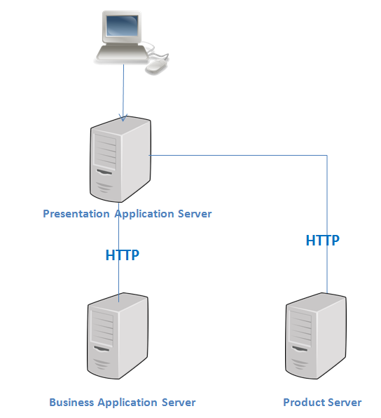
RESTful Product Component

Slide 36
Main Point
REST fits into a well-designed N-tier application enterprise very easily.
Life is well designed and built in layers, accommodating change very easily.

Slide 37
Oauth2
Industry-standard protocol for authorization.
Stateless - no HTTP session
Provides authentication and authorization as a service.
Allows limited application access to HTTP services [e.g. Google]
Supports Single Sign On [SSO]
Token based
Advantages of Tokens over Http Sessions:
Reduced server load
Streamlined permission management
Support for distributed and cloud-based infrastructure.
RFC 6749

Slide 38
OAuth2 Roles
Resource owner (the User) – an entity capable of granting access to a protected resource (for example end-user).
Client – an application making protected resource requests on behalf of the resource owner and with its authorization.
Authorization server – the server issuing access tokens to the client after successfully authenticating the resource owner and obtaining authorization.
Resource server (the Rest API server) – the server hosting the protected resources, capable of accepting/ responding to protected resource requests using access tokens.

Slide 39
Grant Types
Authorization Code:
Used with server-side Applications
Most commonly used because it is optimized for
server- side applications
Implicit:
used with Mobile Apps or Web Applications that run on the
user's device – SPAs [Angular, React]
Resource Owner Password Credentials:
Used with Trusted Applications best suited when both the
client and the servers are from same company.
Client Credentials:
Used with non interactive application [e.g Batch].Token issued
directly to application

Slide 40
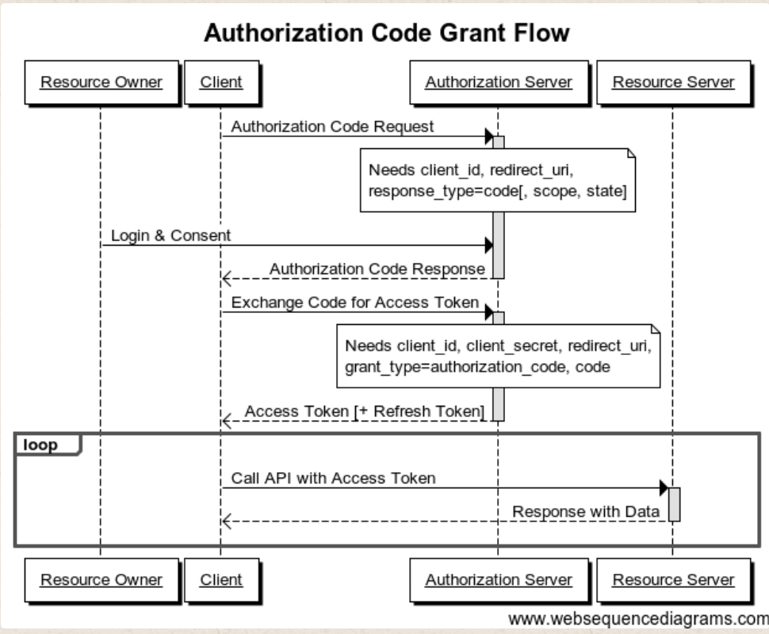
Authorization Code
Users Browser
MVC Server
REST Server: co-located in Demo
“properties” information - Needed to Config Application
See Slide 42

Slide 41
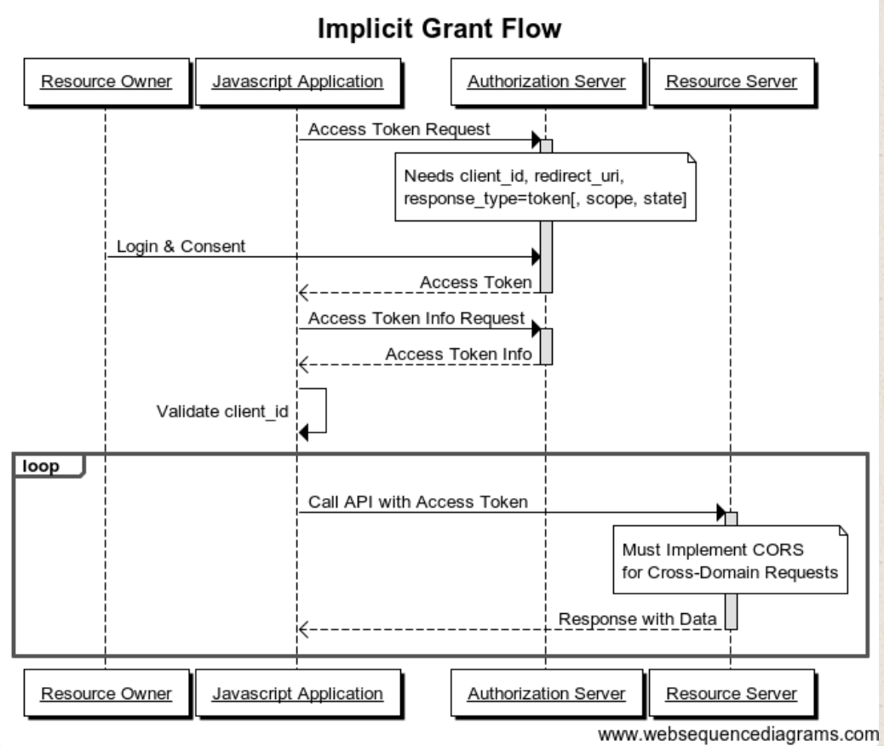
Implicit Grant
Users Browser
REST Server: co-located in Demo
“properties” information - Needed to Config Application
See Slide 42

Slide 42
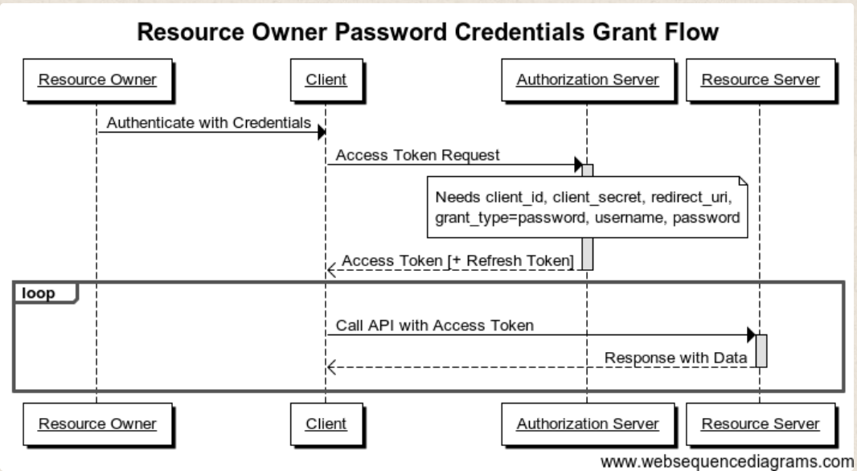
Resource Owner Password Credentials
Client Server
REST Server
“properties” information - Needed to Config Application
See Slide 42

Slide 43
Oauth2 Server Configuration
void configure(final ClientDetailsServiceConfigurer clients) throws Exception {
clients.inMemory()
.withClient("SampleClientId")
.secret(passwordEncoder.encode("secret"))
.authorizedGrantTypes("authorization_code","refresh_token")
.scopes("user_info")
.redirectUris("http://localhost:8083/MemberMVCOauthTest/login")
.accessTokenValiditySeconds(30)
.and()
.withClient("MemberMVCOauthPwd")
.secret(passwordEncoder.encode("FooBar"))
.authorizedGrantTypes("password", "refresh_token")
.scopes("read")
.accessTokenValiditySeconds(10)
.and()
.withClient("ImplicitClientId")
.secret(passwordEncoder.encode("FooBar"))
.authorizedGrantTypes("implicit")
.redirectUris("http://localhost:8181/MemberOauthImplicit/index.html")
.scopes("read");
See MemberRestOauth Demo
Notes:
https://security.stackexchange.com/questions/44214/what-is-the-purpose-of-oauth-2-0-redirect-uri-checking
The OAuth 2.0 specification's authorization code mechanism includes redirect URI checking from the site you redirect to. See steps D and E in section 4.1 of the spec. Also, section 4.1.3 describes in detail that the redirected-to client needs to transmit redirect_uri, and that it needs to match that of the initial authorization request.
AND by default Spring successful login goes to the CALLING Page [ /welcome OR /members for our app…]

Slide 44
Authorization Code Client
W/ SSO
@EnableOAuth2Sso
@Configuration
public class UiSecurityConfig extends WebSecurityConfigurerAdapter {
__________________________________________________________________________
server:
port: 8083
servlet:
context-path: /MemberMVCOauthTest
security:
oauth2:
client:
clientId: SampleClientId
clientSecret: secret
accessTokenUri: http://localhost:8080/MemberRestOauth/oauth/token
userAuthorizationUri: http://localhost:8080/MemberRestOauth/oauth/authorize
resource:
userInfoUri: http://localhost:8080/MemberRestOauth/user
spring:
autoconfigure:
See MemberRestOauthCode Demo
Notes:
accessTokenUri is the URI to obtain the Access Tokens
userAuthorizationUri is the authorization URI that users will be redirected to
userInfoUri the URI of user endpoint to obtain current user details
When we use the @EnableResourceServer annotation and we configure a userInfoUri property, spring-boot (by convention) calls the AS to get the fresh user data at any call (with the token) received by RS.
GET api/v1/users/me Gets additional information about the current user
The AbstractAuthenticationProcessingFilter has a method setAuthenticationSuccessHandler that allows you to control this, so if you have access to the OAuth2ClientAuthenticationProcessingFilteryou can set it to what you want. OTHERWISE uses TRIGGER Location

Slide 45
Token-based
Resource Server [REST] Calls
public HttpHeaders getHttpHeaders() {
Authentication authentication =
SecurityContextHolder.getContext().getAuthentication();
OAuth2AuthenticationDetails details =
(OAuth2AuthenticationDetails) authentication.getDetails();
String accessToken = details.getTokenValue();
String authHeader = "Bearer " + accessToken;
HttpHeaders requestHeaders = new HttpHeaders();
requestHeaders.set("Authorization", authHeader);
Notes:
The OAuth 2.0 Authorization Framework: Bearer Token Usage
https://tools.ietf.org/html/rfc6750

Slide 46
Google as SSO with Authorization Code based token
server:
port: 8083
servlet:
context-path: /MemberMVCOauthGoogle
security:
oauth2:
client:
clientId: 634044519076...apps.googleusercontent.com
clientSecret: Cyd4EgRs-H-XoQDK2W5NovYs
accessTokenUri: https://www.googleapis.com/oauth2/v3/token
userAuthorizationUri: https://accounts.google.com/o/oauth2/auth
token-name: oauth_token
clientAuthenticationScheme: form
scope: profile email
resource:
userInfoUri: https://www.googleapis.com/userinfo/v2/me
Notes:
https://www.baeldung.com/spring-security-oauth-principal-authorities-extractor
When acting as an OAuth client and authenticating users through a third party there are three steps we need to consider:
User authentication – the user authenticates with the third party
User authorization – follows authentication, it’s when the user allows our application to perform certain operations on their behalf; this is where scopes come in
Fetch user data – use the OAuth token we’ve obtained to retrieve user’s data
Once we retrieve the user’s data, Spring is able to automatically create the user’s Principal and Authorities.

Slide 47
Implicit Client
index.html:
<button type="button" class='btn btn-lg btn-success btn-mini'
onclick="location.href=
'http://localhost:8080/MemberRestOauth/oauth/authorize‘
+ '?client_id=ImplicitClientId'
+ '&response_type=token'
+ '&state=S5678' "> Login
</button>
Main.js:
var baseURL = 'http://localhost:8080/MemberRestOauth';
//This represents the token you got after login
var authToken = getParams(window.location.href);
function getParams(url) {
var tokenString = "access_token=";
var start = url.search(tokenString) + tokenString.length;
var token = url.substring(start,end);
return token;
Received Token:
http://localhost:8181/MemberOauthImplicit/index.html
#access_token=1dfe59e8-6380-45e8-9e62-e4968262d9cb
&token_type=bearer&state=S5678&expires_in=43199&scope=read

Slide 48
Implicit Resource Server Call
getMember = function() {
$.ajax({
url: baseURL + "/members/1",
type: "get",
dataType: "json",
headers: {
"Authorization": ("Bearer " + authToken)
},
success: function (response) { }

Slide 49
Resource Owner Password Credentials Client
server:
port: 8082
servlet:
context-path: /MemberMVCOauthPwd
security:
oauth2:
client:
clientId: MemberMVCOauthPwd
clientSecret: FooBar
accessTokenUri: http://localhost:8080/MemberRestOauth/oauth/token
userAuthorizationUri: http://localhost:8080/MemberRestOauth/oauth/authorize
resource:
userInfoUri: http://localhost:8080/MemberRestOauth/user/me
spring:
autoconfigure:

Slide 50
Client-Configure Token & Spring Template
protected OAuth2ProtectedResourceDetails resource() {
ResourceOwnerPasswordResourceDetails resource =
new ResourceOwnerPasswordResourceDetails();
resource.setAccessTokenUri(accessTokenUri);
resource.setClientId(clientId);
resource.setClientSecret(clientSecret);
resource.setGrantType("password");
resource.setScope(scopes);
return resource;
}
public OAuth2RestTemplate restTemplate() {
AccessTokenRequest accessTokenRequest = new DefaultAccessTokenRequest();
// Client parameters[resource()] & DefaultAccessTokenRequest passed to
template constructor
return new OAuth2RestTemplate(resource(),
new DefaultOAuth2ClientContext(accessTokenRequest));
}

Slide 51
Simulate Credentials
& Access Resource Server
private void mainInternal() throws IOException {
ResourceOwnerPasswordResourceDetails resource =
(ResourceOwnerPasswordResourceDetails) oAuth2RestTemplate.getResource();
// "Simulate getting user's credentials
while(true) {
String name = in.readLine();
String password = in.readLine();
resource.setUsername(name);
resource.setPassword(password);
_______________________________________________________________________
public List<Member> findAll() throws OAuth2AccessDeniedException {
// Use OAuth2RestTemplate - token setup in config & populated with
username/password from console input [see previous slide]
OAuth2RestTemplate oAuth2RestTemplate = restHelper.getOAuth2RestTemplate();
ResponseEntity<Member[]> responseEntity =
oAuth2RestTemplate.getForEntity(baseUrl, Member[].class);
List<Member> userList = Arrays.asList(responseEntity.getBody());
return userList;

Slide 52
Access Token Strategy
Managed by Authorization Server
Two types
Self-contained
Token has credentials as content
e.g. JWT
Token is signed
Public Key made available to Resource Server
Reference
Token is a random “unique” string
Key to credentials stored
in-memory, cached or datastore
See OAuth2 Guide - Managing Tokens Section
Notes:
REDDIS NoSQL key/value cache/datastore
https://projects.spring.io/spring-security-oauth/docs/oauth2.html
Explains TokenStore & TokenServices

Slide 53
JWT Token
Three Parts
Header JWT Content
Type of token and hashing algorithm
"alg": "HS256",
"typ": "JWT"
Payload
defined by “registered claims” See Registered JWT Claims
Additional custom claims are allowed for sub, iss, exp definitions
"sub": “admin",
"scopes": Custom claim
“authority": "ROLE_ADMIN“
"iss": "http://mum.edu",
"exp": 1508625322
Signature
Signature ensures token not tampered with - signed with a private key
HMACSHA256( base64(header) + "." + base64 (payload), secret)
Notes:
Secret is made available to Resource server
JWTs can be signed using a secret (with the HMAC algorithm) or a public/private key pair using RSA or ECDSA.
“exp” is a NUMERICDATE
NumericDate is the last definition in Section 2. Terminology, and is defined as the number of seconds (not milliseconds) since Epoch:
A JSON numeric value representing the number of seconds from 1970-01-01T00:00:00Z UTC until the specified UTC date/time, ignoring leap seconds.
This is equivalent to the IEEE Std 1003.1, 2013 Edition [POSIX.1] definition "Seconds Since the Epoch", in which each day is accounted for by exactly 86400 seconds,
other than that non-integer values can be represented. See RFC 3339 [RFC3339] for details regarding date/times in general and UTC in particular.

Slide 54
Reference Token
Database Example used by Reference Token
Access Token is Key to Database
Access is directly from Resource Server
Table: oauth_access_token
Columns:
token_id VARCHAR(256), Access Token
token LONG VARBINARY,
authentication_id VARCHAR(256) PRIMARY KEY,
user_name VARCHAR(256),
client_id VARCHAR(256),
authentication LONG VARBINARY, Authentication/Authorities Blob
refresh_token VARCHAR(256)
Spring OAuth2 Schema
Notes:
https://techannotation.wordpress.com/2015/06/17/spring-oauth2-with-authorization-code/
The columns token and authentication contain the serialized token and authentication object.
The token_id and refresh_token are the encoded access token values.
https://stackoverflow.com/questions/32475105/how-is-the-authentication-blob-field-of-the-table-oauth-access-token-table-gener
Spring will create authentication object including the authorities for the user using this field.

Slide 55
Main Point
OAuth2 is a token based protocol for authorization. Tokens provide streamlined permission management and support for distributed and cloud-based infrastructure.
Science of Consciousness: Cosmic Consciousness is characterized by the right action at the right time for full effectiveness.

